Slide 1
Xeno-Flight
By: Ethan clayton & ajai Gorowara
Arizona State University
CPI 111: game design
Spring 2018

Slide 2
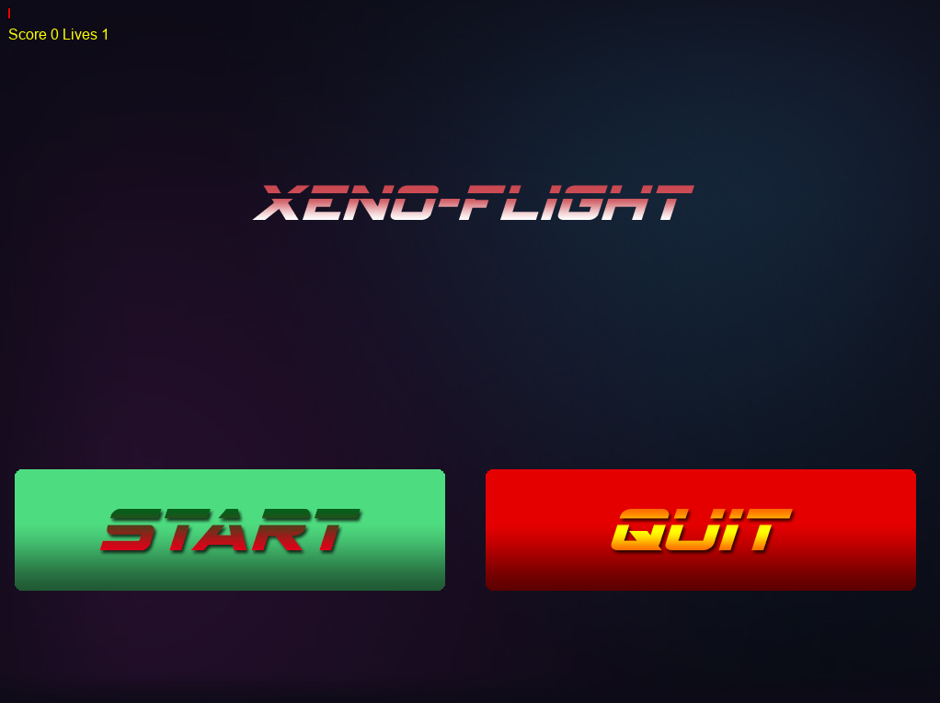
Genre
The game can be considered a Shoot ‘em up, as noted by

Slide 3

Story
The game takes place in the future,
Technology on Earth has become extremely advanced
Aliens invade the planet in fear of the advanced technology
They wish to destroy the planet.
To combat the invasion,
All of Earth's greatest powers combine their technology to create the Star Wing.
The Star Wing is the only ship capable of defeating the invasion.
The Players’ role is to pilot the Star Wing through multiple levels,
At the end of each level is an alien boss which must be defeated in order to move to the next level
The invasion is complete when all the all aliens, all the bosses and all the levels are completed.

Slide 4
Main Objectives
Complete each level
Must shoot down or dodge fire from alien ships as the player progresses through a level
Players can collect health canisters and weapon upgrades to give them an advantage
Player win (completes a level) if they can defeat a boss at the end of the level
Obtain the highest score
Score is gained over time while alive and from shooting down enemy ships
The player starts each level with a number of lives depending on the ship they have chosen
The player loses if the ship loses all lives during the level

Slide 5
Development Experience
Things that went right
Consistency of art assets, menu items, music, etc. SO WHAT
We were able to code efficiently and had very little errors in our code
We were able to follow our design documents and had little to no changes between our game and the documents
Things that went wrong
Fell behind on schedule,
We ended up having to spend more time on the game then what was planned for late into the semester due to other classes and coursework taking up time
Disorganized code caused extra time to be spent investigate inconsistencies

Slide 6
What did we learn
Following our set timeline could have made our work easier, as we spent more time on the game than what we had originally expected
Organizing our code and objects can help keep our work cleaner and simpler, as it makes it easier to find code and objects during debugging

Slide 7
Future plans?
Future development of the game can involve creating multiple levels
New types of enemies and bosses that employ unique ideas, like bullet patterns and movements
Different ship types that employ unique attributes, like dodging and shields
Different types of upgrades like shields, screen wiping moves, etc.

Slide 8
Asset credits
Music and background images were used from Professor Brain Nelson Space Shooter lesson
Titles and menu items were created by Ajai Gorowara
Ships, enemies, explosions, and in-game objects were created by Ethan Clayton

